Slide 1
Lecture 8
Romberg integration

Slide 2



Introduction
In previous lectures we learned how the error of composite methods behave
Truncation error $O\left(h^{q}\right)$
Log(Error)
Round-off error
Truncation error $O\left(h^{p}\right)$
$$p>q$$
Smallest
achievable error
Log(h)
Notes:
In previous lectures we learned how the error of composite methods behave
The total error has two contributions, truncation and round-off errors
As one uses smaller values of h, the error decreases according the order of the truncation error
For smaller values of h, round-off errors take over
As a consequence, there is a smallest possible error that can be achieved given a quadrature formula and given a number of digits used in the calculations
This observation motivates the development of higher order quadrature formulas
If one wants to reduce this limit in achievable error, one has to use a quadrature method with a higher order

Slide 3
Higher Order Quadrature Formulas
Develop new methods with more interpolating points
Develop better quadrature formulas by placing in a smarter way interpolating points
Romberg integration
Notes:
There are several ways to develop higher order methods
Possible ways include
- Develop new methods with more interpolating points
- Develop better quadrature formulas by placing in a smarter way interpolating points
This aspect will be discussed in a coming lecture
A third possible way, among many more that exists, is the Romberg integration
In this lecture we will explore this third way

Slide 4
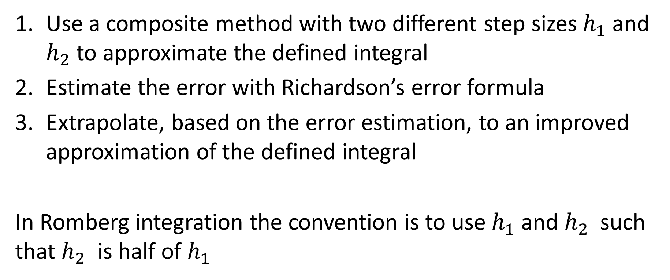
Overview of Romberg Integration
Use a composite method with two different step sizes $h_{1}$ and $h_{2}$ to approximate the defined integral
Estimate the error with Richardson’s error formula
Extrapolate, based on the error estimation, to an improved approximation of the defined integral
In Romberg integration the convention is to use $h_{1}$ and $h_{2}$ such that $h_{2}$ is half of $h_{1}$
Notes:
Let us give an overview of Romberg’s integration method
First we use a composite method with two different step sizes $h_{1}$ and $h_{2}$ to approximate the defined integral
Second, we estimate the error with Richardson’s error formula
And third we extrapolate, based on the error estimation, to an improved approximation of the defined integral
We will now explain in details each of these steps
Note that in Romberg integration the convention is to use $h_{1}$ and $h_{2}$ such that $h_{2}$ is half of $h_{1}$
We will follow this convention

Slide 5
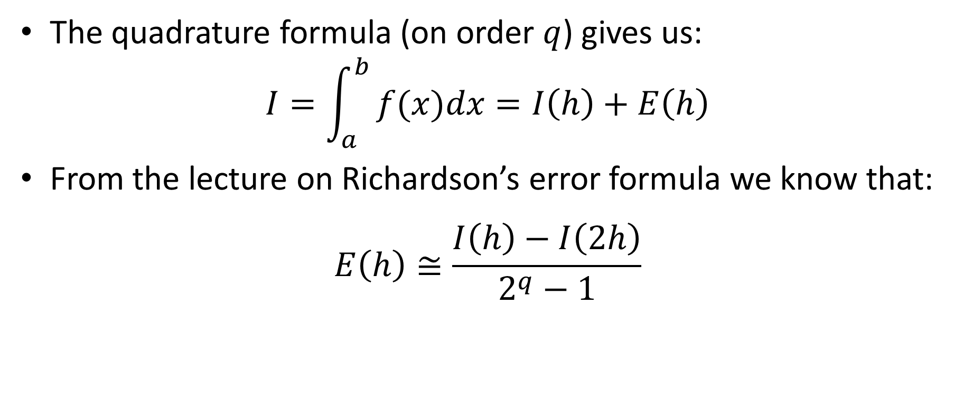
Romberg Extrapolation
The quadrature formula (on order $q$) gives us:
$$I=\int_{a}^{b}{⁡f(x)dx}=I\left(h\right)+E\left(h\right)$$
From the lecture on Richardson’s error formula we know that:
$$E\left(h\right)≅\frac{I\left(h\right)−I\left(2h\right)}{2^{q}−1}$$
Notes:
Let us now discuss the first two steps which consist in applying a composite method with two steps sizes h1=2h and h2=h followed by the estimation of the error using the Richardson error formula
From the lecture on Richardson’s error formula we know that the error is estimated as
$$E\left(h\right)≅\frac{I\left(h\right)−I\left(2h\right)}{2^{q}−1}$$
as we used as first step size h1=2h and second step size h2=h

Slide 6
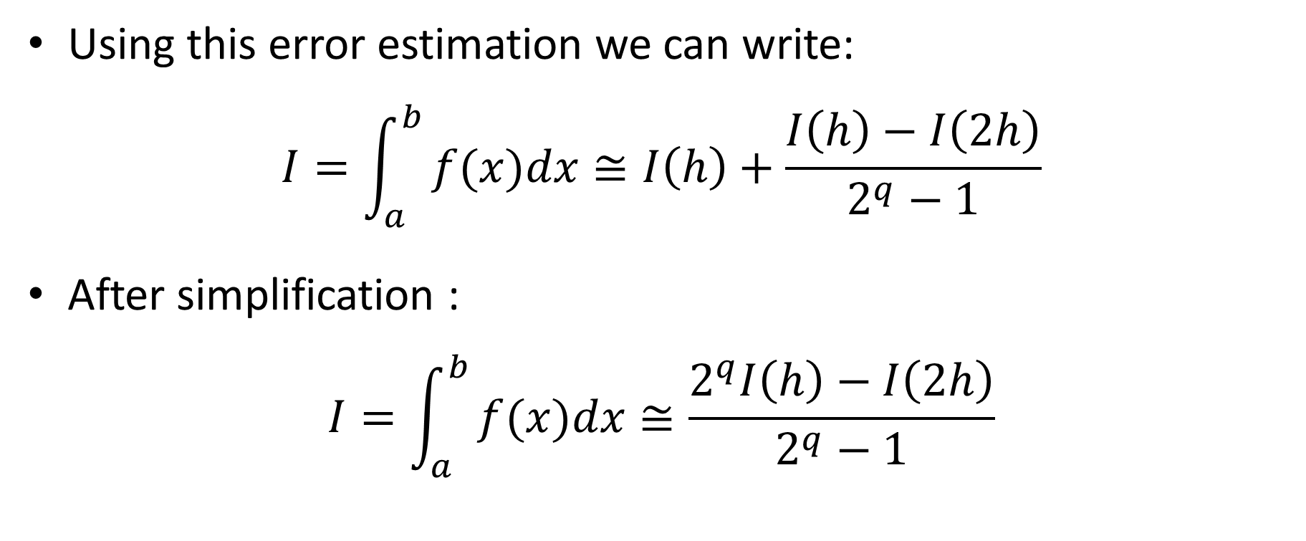
Romberg Extrapolation
Using this error estimation we can write:
$$I=\int_{a}^{b}{⁡f(x)dx}≅I\left(h\right)+\frac{I\left(h\right)−I\left(2h\right)}{2^{q}−1}$$
After simplification :
$$I=\int_{a}^{b}{⁡f(x)dx}≅\frac{2^{q}I\left(h\right)−I\left(2h\right)}{2^{q}−1}$$
Notes:
Next step is the extrapolation step
As we can estimate the error with Richardson, we can use this estimation to improve the approximation provided by the quadrature method
Our defined integral can therefore be estimated as I(h), the approximation provided by our quadrature method using a step size h, plus the error estimation form Richardson which is $\frac{I\left(h\right)−I\left(2h\right)}{2^{q}−1}.$ Here I(2h) is the approximation calculated by our quadrature method with a step size 2h and q is the order of the quadrature method
We can simplify this expression and obtain an approximation of our defined integral as $\frac{2^{q}I\left(h\right)−I\left(2h\right)}{2^{q}−1}$

Slide 7

Romberg Theorem
Theorem
Let $I\left(h\right)$ be a quadrature formula for a defined integral with a truncation error in $O\left(h^{q}\right)$. Then
$$R(h)=\frac{2^{q}I\left(h\right)−I\left(2h\right)}{2^{q}−1}$$
is an approximation of the defined integral with a truncation error in $O\left(h^{q+2}\right)$
Notes:
The usefulness of Romberg’s extrapolation comes from the following theorem
Let $I\left(h\right)$ be a quadrature formula for a defined integral with a truncation error in $O\left(h^{q}\right)$. Then
$$R(h)=\frac{2^{q}I\left(h\right)−I\left(2h\right)}{2^{q}−1}$$
is an approximation of the defined integral with a truncation error in $O\left(h^{q+2}\right)$
What does that mean and imply?
This theorem shows that whenever you add the Richardson error estimation to an approximation of the defined integral, you obtain a better approximation of the integral, the so-called Romberg approximation R(h)
This is rather expected as we learned previously that the Richardson error formula is an excellent approximation of the truncation error
What is unexpected that this improved approximation is significantly better, in fact two orders better

Slide 8
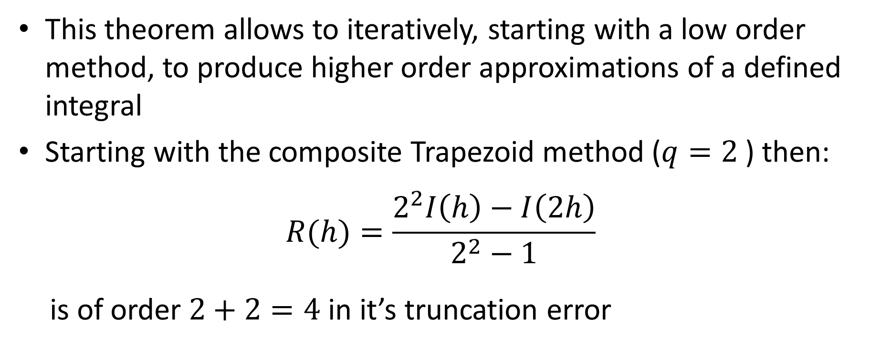
Romberg Integration
This theorem allows to iteratively, starting with a low order method, to produce higher order approximations of a defined integral
Starting with the composite Trapezoid method ($q=2$) then:
$$R(h)=\frac{2^{2}I\left(h\right)−I\left(2h\right)}{2^{2}−1}$$
is of order $2+2=4$ in it’s truncation error
Notes:
How can we use this result?
This theorem allows to iteratively, starting with a low order method, to produce higher order approximations of a defined integral
For example, if we start with the composite Trapezoid method, which is in second order, then the improved approximation
$$R(h)=\frac{2^{2}I\left(h\right)−I\left(2h\right)}{2^{2}−1}$$
is of order 4 in the truncation error
Which means it is as precise as Simpson 1/3 rule!

Slide 9
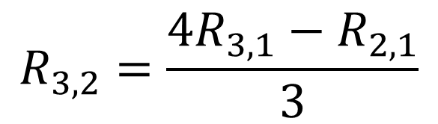



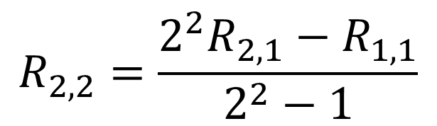





Romberg Integration
We can produce several of such approximations
$$O\left(h^{2}\right)$$
$$O\left(h^{4}\right)$$
$$h$$
$$R_{1,1}$$
$$R_{2,2}=\frac{2^{2}R_{2,1}−R_{1,1}}{2^{2}−1}$$
$$\frac{h}{2}$$
$$R_{2,1}$$
$$\frac{h}{4}$$
$$R_{3,2}=\frac{4R_{3,1}−R_{2,1}}{3}$$
$$R_{3,1}$$
Notes:
Now, we can produce several of such approximations with various step sizes all multiple of two for each others
Let us produce approximations for step size of h, h/2 and h/4
For each of these step sizes we use the composite trapezoid rule to calculate the approximation of the defined integral
All these approximations will be in order two
Let us call the produced approximations R11, R21 and R31
We use here a systematic notation
The first index represents the line of the table we are producing and the second index is the column of the table
Based on this first column, which we generated using the composite trapezoid rule, we can generate a second column with Romberg approximations
For example R22 is computed based on R12 and R22
Note the exponent “2” in the Romberg formula which is because the composite Trapezoid method is of order 2
Same way we get R32 by calculating 4 times R31, the more precise, minus one times R21, the less precise, divided by 3

Slide 10

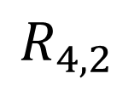


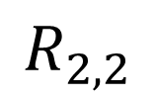

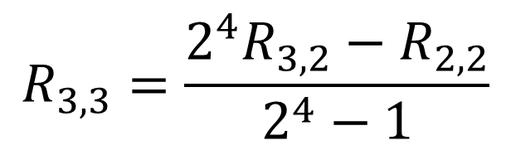
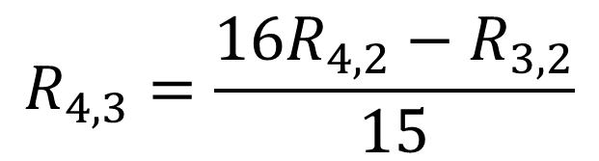
Romberg Integration
From which can get higher order approximations
$$O\left(h^{2}\right)$$
$$O\left(h^{4}\right)$$
$$O\left(h^{6}\right)$$
$$R_{1,1}$$
$$R_{2,1}$$
$$R_{2,2}$$
$$R_{3,3}=\frac{2^{4}R_{3,2}−R_{2,2}}{2^{4}−1}$$
$$R_{3,1}$$
$$R_{3,2}$$
$$R_{4,3}=\frac{16R_{4,2}−R_{3,2}}{15}$$
$$R_{4,1}$$
$$R_{4,2}$$
Notes:
Based on the Romberg approximations of the second column, which are of order 4, we can generate even more precise approximations of our defined integral
These new approximations will be of order 4+2=6
R33 is generated combining the result R22 and R32
Note the exponent four, which comes from the fact that the second column was of order 4
Same way we get R43 by calculating 16 times R42, the more precise, minus one times R32, the less precise, divided by 15

Slide 11






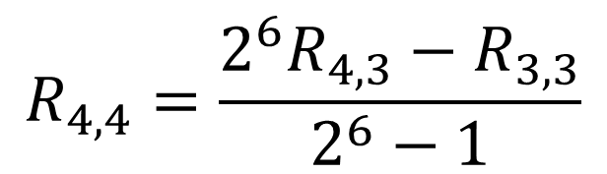


Romberg Integration
From which can get higher order approximations
$$O\left(h^{2}\right)$$
$$O\left(h^{4}\right)$$
$$O\left(h^{6}\right)$$
$$O\left(h^{8}\right)$$
$$R_{1,1}$$
$$R_{2,1}$$
$$R_{2,2}$$
$$R_{3,1}$$
$$R_{3,2}$$
$$R_{3,3}$$
$$R_{4,4}=\frac{2^{6}R_{4,3}−R_{3,3}}{2^{6}−1}$$
$$R_{4,1}$$
$$R_{4,2}$$
$$R_{4,3}$$
Notes:
Based on the Romberg approximations of the third column, which are of order 6, we can generate even more precise approximations of our defined integral
These new approximations will be of order 6+2=8
R44 is generated combining the result R33 and R43
Note the exponent six, which comes from the fact that the second column was of order 6

Slide 12

















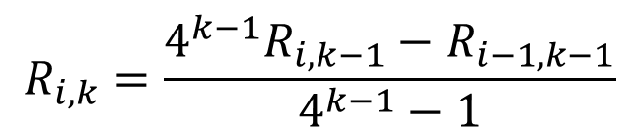



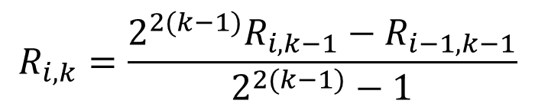










Romberg Integration
$$O\left(h^{2}\right)$$
$$O\left(h^{4}\right)$$
$$O\left(h^{6}\right)$$
$$O\left(h^{8}\right)$$
$$O\left(h^{10}\right)$$
$$i=1$$
$$R_{1,1}$$
$$R_{i,k}=\frac{2^{2(k−1)}R_{i,k−1}−R_{i−1,k−1}}{2^{2(k−1)}−1}$$
$$i=2$$
$$R_{2,1}$$
$$R_{2,2}$$
$$i=3$$
$$R_{3,1}$$
$$R_{3,2}$$
$$R_{3,3}$$
$$R_{i,k}=\frac{4^{k−1}R_{i,k−1}−R_{i−1,k−1}}{4^{k−1}−1}$$
$$i=4$$
$$R_{4,1}$$
$$R_{4,2}$$
$$R_{4,3}$$
$$R_{4,4}$$
$$i=5$$
$$R_{5,1}$$
$$R_{5,2}$$
$$R_{5,3}$$
$$R_{5,4}$$
$$R_{5,5}$$
$$k=1$$
$$k=2$$
$$k=3$$
$$k=4$$
$$k=5$$
Notes:
Now we presented the idea, let us explain in a generic way how a Romberg integration table is built
We present as an example a table where we will have 5 columns and 5 lines
Lines are numbered with the index i and the columns with the index k
Each column will contain a series of approximation of our defined integral with increasing order.
The first column, generated with the composite trapezoid rule, is of order 2
Subsequent columns will be of order 4, 6, 8 and 10
Recall that each line corresponds to the application of the composite trapezoid rule with decreasing h
Line one is with h, line two with h/2, line 3 with h/4, line 4 with h/8 and line 5 with h/16
This allows us to compute the approximations R11, R21 etc until R51 of the first column
Note this is the lengthy part of the work
Starting from this first column, we compute the entries of the second until 5th column the way we explained in previous slides
This is achieved using the Romberg formula
Note the value of the exponent of the 2 in the formula. This value is 2(k-1), which is the order of the column k-1
This formula can be rewritten as shown

Slide 13
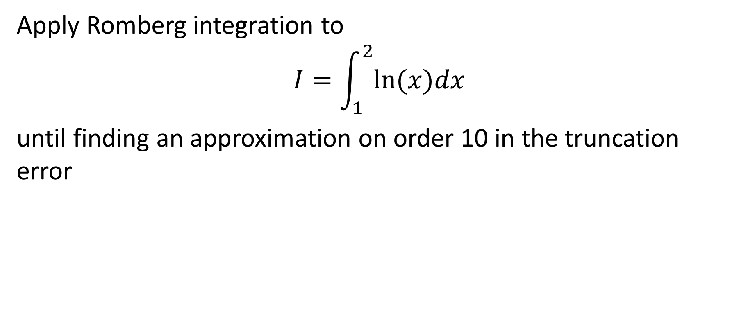
Example
Apply Romberg integration to
$$I=\int_{1}^{2}{ln⁡(x)dx}$$
until finding an approximation on order 10 in the truncation error
Notes:
Let us apply Romberg integration on an example
We use the defined integral from 1 to 2 of the natural log function
We want to generate approximations until we reach an approximation of order 10

Slide 14
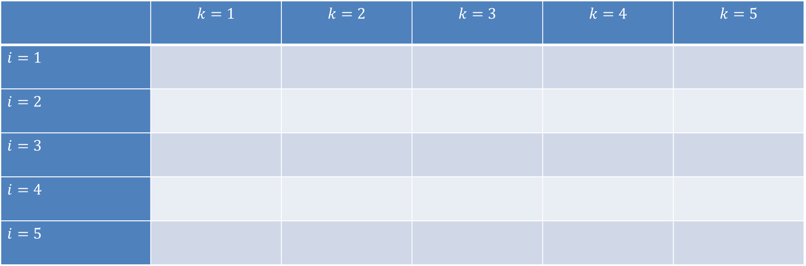
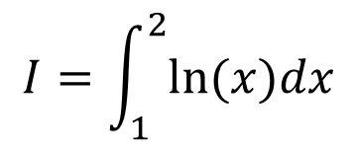
Example
$$I=\int_{1}^{2}{ln⁡(x)dx}$$
 | $$k=1$$ | $$k=2$$ | $$k=3$$ | $$k=4$$ | $$k=5$$
$i=1$
$i=2$
$i=3$
$i=4$
$i=5$
Notes:
We start by preparing a table with 5 columns and 5 lines
We will need five columns because we want to reach an approximation in order 10 which will be the case for column k=5

Slide 15
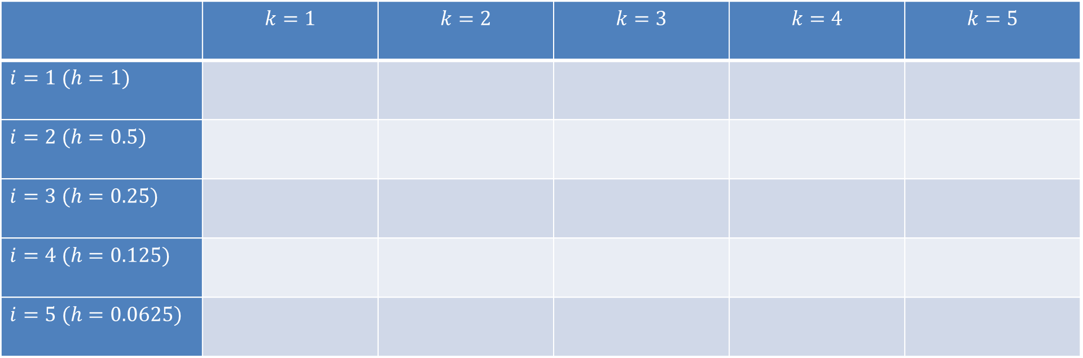
Example
$$I=\int_{1}^{2}{ln⁡(x)dx}$$
 | $$k=1$$ | $$k=2$$ | $$k=3$$ | $$k=4$$ | $$k=5$$
$i=1$ $(h=1)$
$i=2$ $(h=0.5)$
$i=3$ $(h=0.25)$
$i=4$ $(h=0.125)$
$i=5$ $(h=0.0625)$
Notes:
For the five lines we have to chose the values of h
Usually, for i=1 one choses h as being the integration interval. In our case it is 2-1=1
Based on this choice, the subsequent lines have values of h equal to 0.5, 0.25, 0.125 and 0.0625

Slide 16
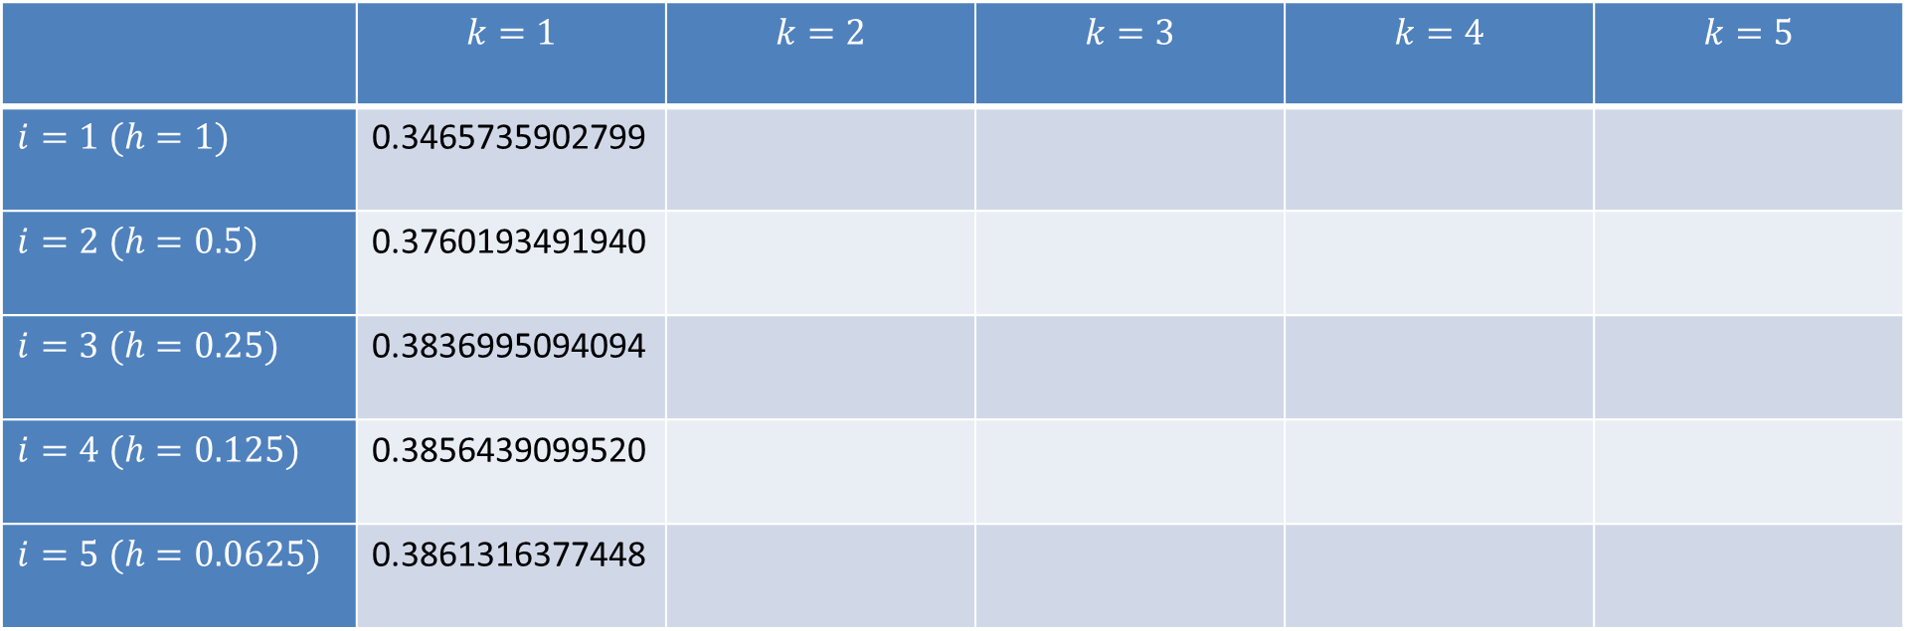
Example
Composite Trapezoid
method
 | $$k=1$$ | $$k=2$$ | $$k=3$$ | $$k=4$$ | $$k=5$$
$i=1$ $(h=1)$ | 0.3465735902799
$i=2$ $(h=0.5)$ | 0.3760193491940
$i=3$ $(h=0.25)$ | 0.3836995094094
$i=4$ $(h=0.125)$ | 0.3856439099520
$i=5$ $(h=0.0625)$ | 0.3861316377448
Notes:
We fill the first column by executing the composite trapezoid rule with the corresponding values of h
This is the lengthy part of the method
I invite you to try to produce this column using your octave script you developed for the trapezoid composite method
Once this first column is computed, the reminder of the columns are straight forward to calculate

Slide 17
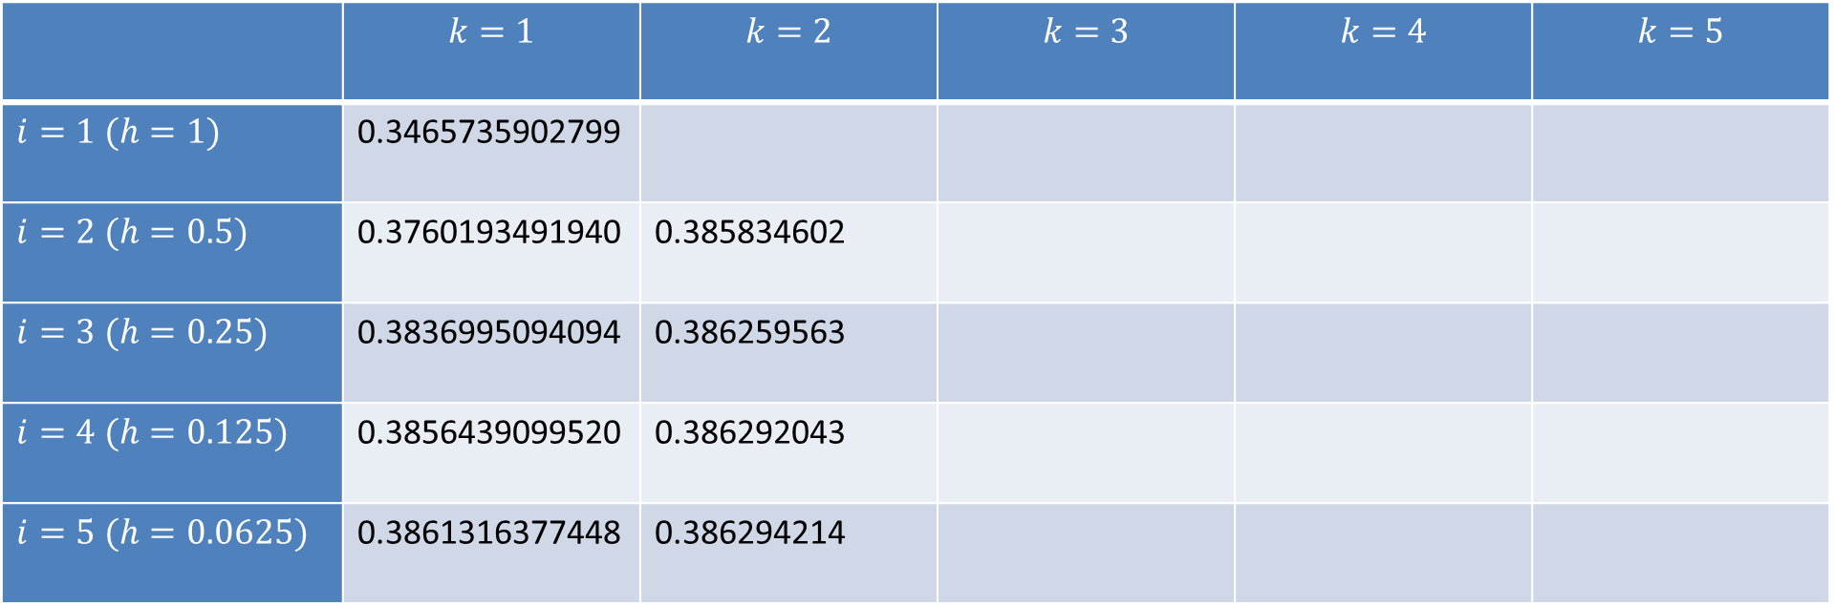

Example
Composite Trapezoid
method
$$R_{2,2}=\frac{4R_{2,1}−R_{1,1}}{3}$$
 | $$k=1$$ | $$k=2$$ | $$k=3$$ | $$k=4$$ | $$k=5$$
$i=1$ $(h=1)$ | 0.3465735902799
$i=2$ $(h=0.5)$ | 0.3760193491940 | 0.385834602
$i=3$ $(h=0.25)$ | 0.3836995094094 | 0.386259563
$i=4$ $(h=0.125)$ | 0.3856439099520 | 0.386292043
$i=5$ $(h=0.0625)$ | 0.3861316377448 | 0.386294214
Notes:
The second column is computed with the Romberg formula
For example the first line of the column is $R_{2,2}=\frac{4R_{2,1}−R_{1,1}}{3}$
Same way, we compute the other lines.

Slide 18
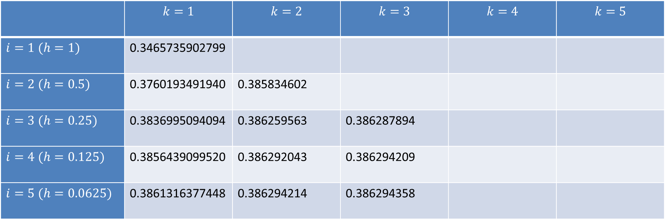

Example
Composite Trapezoid
method
$$R_{2,2}=\frac{4R_{2,1}−R_{1,1}}{3}$$
$$R_{3,3}=\frac{16R_{3,2}−R_{2,2}}{15}$$
 | $$k=1$$ | $$k=2$$ | $$k=3$$ | $$k=4$$ | $$k=5$$
$i=1$ $(h=1)$ | 0.3465735902799
$i=2$ $(h=0.5)$ | 0.3760193491940 | 0.385834602
$i=3$ $(h=0.25)$ | 0.3836995094094 | 0.386259563 | 0.386287894
$i=4$ $(h=0.125)$ | 0.3856439099520 | 0.386292043 | 0.386294209
$i=5$ $(h=0.0625)$ | 0.3861316377448 | 0.386294214 | 0.386294358
Notes:
We proceed then with the column number 3
The first line of the column is $R_{3,3}=\frac{16R_{3,2}−R_{2,2}}{15}$
Same way, we compute the other lines.

Slide 19
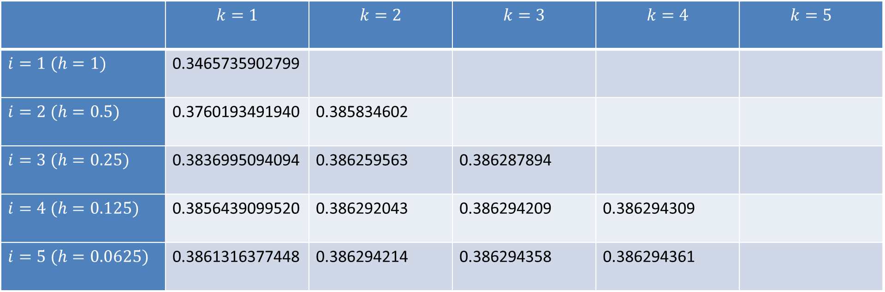

Example
Composite Trapezoid
method
$$R_{2,2}=\frac{4R_{2,1}−R_{1,1}}{3}$$
$$R_{3,3}=\frac{16R_{3,2}−R_{2,2}}{15}$$
$$R_{4,4}=\frac{64R_{4,3}−R_{3,3}}{63}$$
 | $$k=1$$ | $$k=2$$ | $$k=3$$ | $$k=4$$ | $$k=5$$
$i=1$ $(h=1)$ | 0.3465735902799
$i=2$ $(h=0.5)$ | 0.3760193491940 | 0.385834602
$i=3$ $(h=0.25)$ | 0.3836995094094 | 0.386259563 | 0.386287894
$i=4$ $(h=0.125)$ | 0.3856439099520 | 0.386292043 | 0.386294209 | 0.386294309
$i=5$ $(h=0.0625)$ | 0.3861316377448 | 0.386294214 | 0.386294358 | 0.386294361
Notes:
Next we fill column number 4
The first line of the column is $R_{4,4}=\frac{64R_{4,3}−R_{3,3}}{63}$
Same way, we compute the other lines.

Slide 20
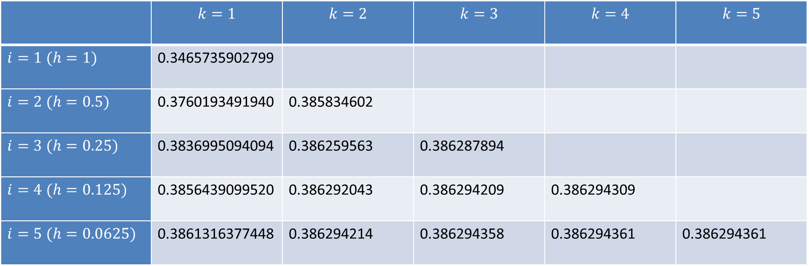

Example
Composite Trapezoid
method
$$R_{2,2}=\frac{4R_{2,1}−R_{1,1}}{3}$$
$$R_{3,3}=\frac{16R_{3,2}−R_{2,2}}{15}$$
$$R_{4,4}=\frac{64R_{4,3}−R_{3,3}}{63}$$
$$R_{5,5}=\frac{256R_{5,4}−R_{4,4}}{255}$$
 | $$k=1$$ | $$k=2$$ | $$k=3$$ | $$k=4$$ | $$k=5$$
$i=1$ $(h=1)$ | 0.3465735902799
$i=2$ $(h=0.5)$ | 0.3760193491940 | 0.385834602
$i=3$ $(h=0.25)$ | 0.3836995094094 | 0.386259563 | 0.386287894
$i=4$ $(h=0.125)$ | 0.3856439099520 | 0.386292043 | 0.386294209 | 0.386294309
$i=5$ $(h=0.0625)$ | 0.3861316377448 | 0.386294214 | 0.386294358 | 0.386294361 | 0.386294361
Notes:
And finally column number 5
This contains only one entry which is $R_{5,5}=\frac{256R_{5,4}−R_{4,4}}{255}$

Slide 21




Example
$$O\left(h^{2}\right)$$
$$O\left(h^{4}\right)$$
$$O\left(h^{6}\right)$$
$$O\left(h^{8}\right)$$
Notes:
As we know the exact value of the defined integral we discuss, we can compute the true error
We can do this for the entries of each column of the table
The first column, which is the composite trapezoid rule, is in order h square
The second column is in order 4
The third column in order 6
And column 4 is in order 8
The single entry of column 5 would be in order 10 but having only a single point we cannot show the trend on the plot
This graph illustrates in an impressive way how Romberg method’s can generate very high order approximations based on a low order method such as the composite Trapezoid method

Slide 22
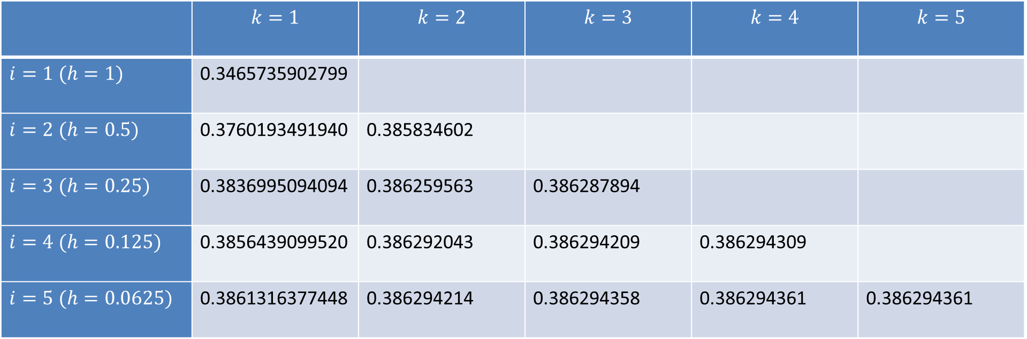
Example
 | $$k=1$$ | $$k=2$$ | $$k=3$$ | $$k=4$$ | $$k=5$$
$i=1$ $(h=1)$ | 0.3465735902799
$i=2$ $(h=0.5)$ | 0.3760193491940 | 0.385834602
$i=3$ $(h=0.25)$ | 0.3836995094094 | 0.386259563 | 0.386287894
$i=4$ $(h=0.125)$ | 0.3856439099520 | 0.386292043 | 0.386294209 | 0.386294309
$i=5$ $(h=0.0625)$ | 0.3861316377448 | 0.386294214 | 0.386294358 | 0.386294361 | 0.386294361
Best approximation
Notes:
In our Romberg table the best approximation is the entry in column 5

Slide 23
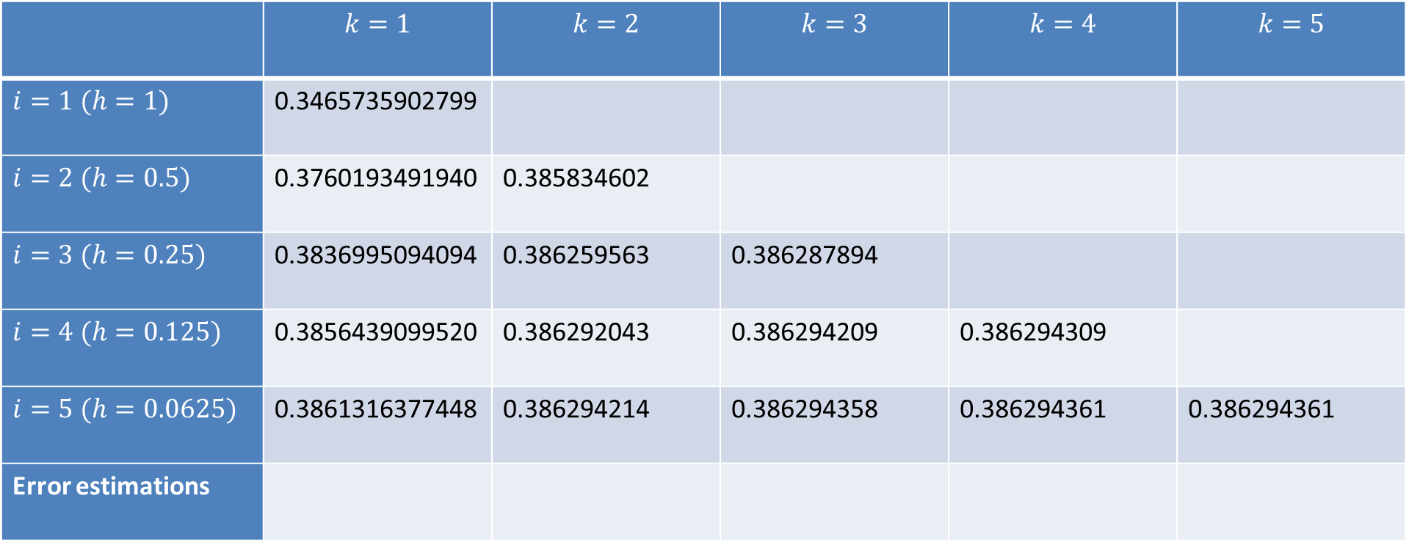




Example
 | $$k=1$$ | $$k=2$$ | $$k=3$$ | $$k=4$$ | $$k=5$$
$i=1$ $(h=1)$ | 0.3465735902799
$i=2$ $(h=0.5)$ | 0.3760193491940 | 0.385834602
$i=3$ $(h=0.25)$ | 0.3836995094094 | 0.386259563 | 0.386287894
$i=4$ $(h=0.125)$ | 0.3856439099520 | 0.386292043 | 0.386294209 | 0.386294309
$i=5$ $(h=0.0625)$ | 0.3861316377448 | 0.386294214 | 0.386294358 | 0.386294361 | 0.386294361
Error estimations
$$E≅\left|\frac{R_{5,1}−R_{4,1}}{2^{2}−1}\right|$$
$$E≅\left|\frac{R_{5,2}−R_{4,2}}{2^{4}−1}\right|$$
$$E≅\left|\frac{R_{5,3}−R_{4,3}}{2^{6}−1}\right|$$
$$E≅\left|\frac{R_{5,4}−R_{4,4}}{2^{8}−1}\right|$$
N.A.
Notes:
Another benefit of Romberg’s method is that we estimate the truncation errors at very low cost
Line 5 of the table contains always the best approximation for a given order
We can use Richardson’s formula to estimate the truncation error of these approximations
Indeed, for each column, except the last, we have approximations with two values of h: h=0.0625 and h=0.125
For the first column the error estimation is given by $\left|\frac{R_{5,1}−R_{4,1}}{2^{2}−1}\right|$.
The exponent two in the denominator is because this column is of order two
For the second column we estimate the error of the last line of the column according $\left|\frac{R_{5,2}−R_{4,2}}{2^{4}−1}\right|$
Again, the exponent four in the denominator is because this column is of order four
The same way we can estimate the errors of the last entries of column 3 and 4
For the last column we can not give any error estimation because we don’t have available two approximations of the integral computed with two different values h

Slide 24
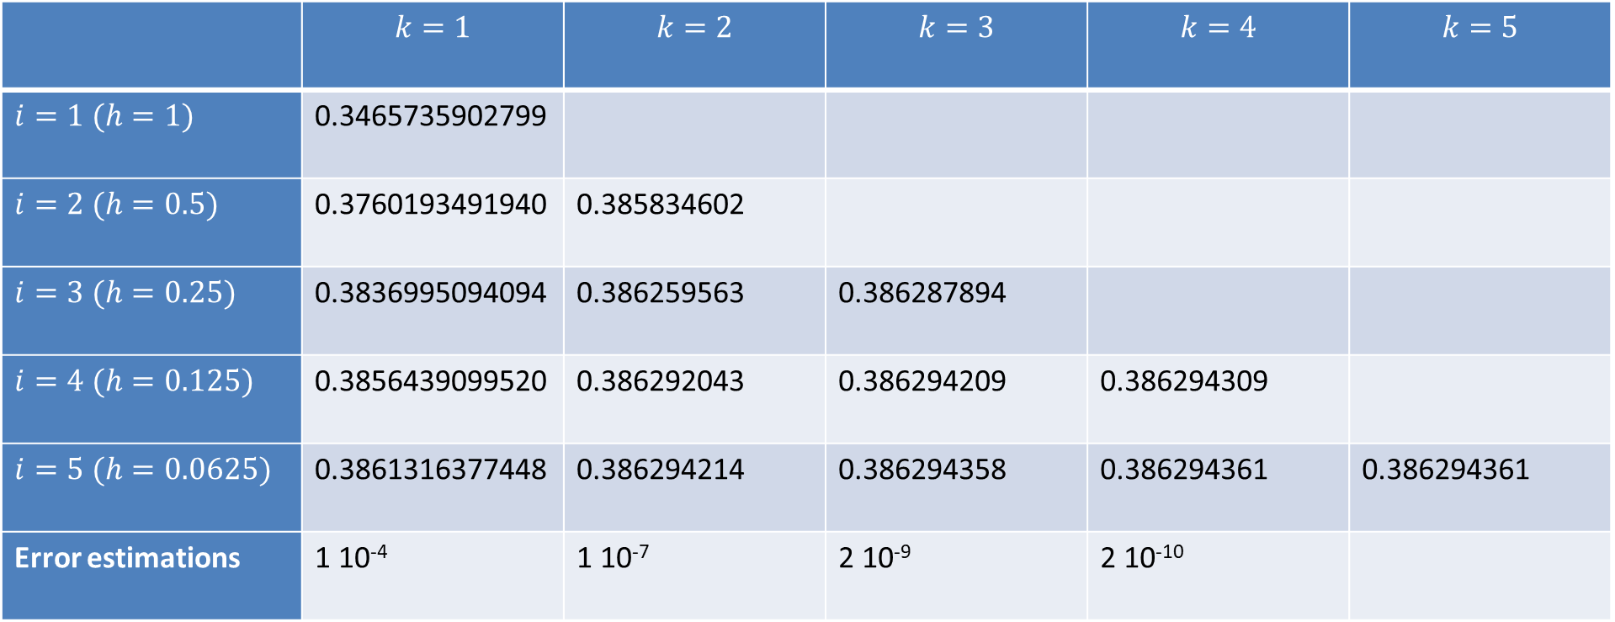
Example
 | $$k=1$$ | $$k=2$$ | $$k=3$$ | $$k=4$$ | $$k=5$$
$i=1$ $(h=1)$ | 0.3465735902799
$i=2$ $(h=0.5)$ | 0.3760193491940 | 0.385834602
$i=3$ $(h=0.25)$ | 0.3836995094094 | 0.386259563 | 0.386287894
$i=4$ $(h=0.125)$ | 0.3856439099520 | 0.386292043 | 0.386294209 | 0.386294309
$i=5$ $(h=0.0625)$ | 0.3861316377448 | 0.386294214 | 0.386294358 | 0.386294361 | 0.386294361
Error estimations | 1 10⁻⁴ | 1 10⁻⁷ | 2 10⁻⁹ | 2 10⁻¹⁰
N.A.
Notes:
If we compute explicitly these values we can observe how the error decreases drastically with each column

Slide 25
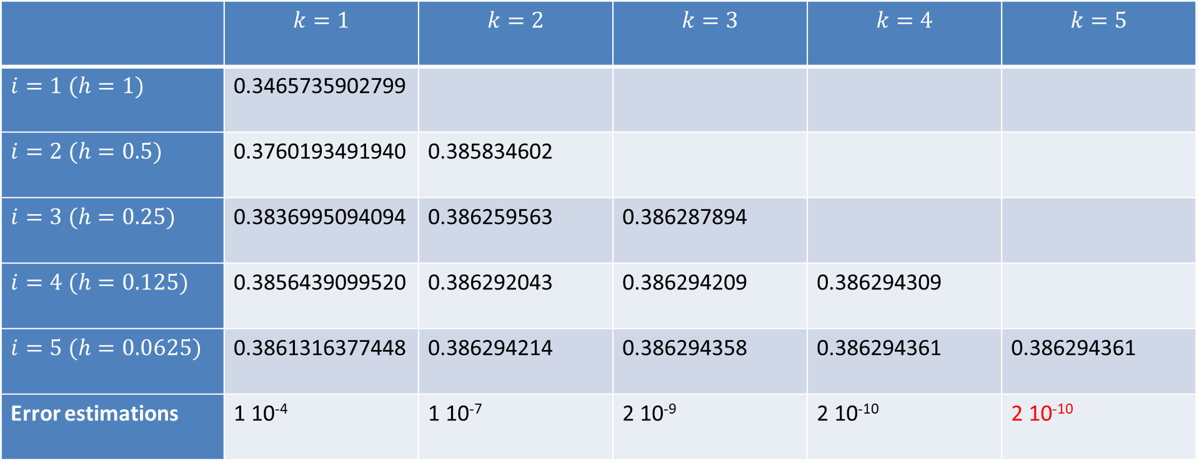
Example
 | $$k=1$$ | $$k=2$$ | $$k=3$$ | $$k=4$$ | $$k=5$$
$i=1$ $(h=1)$ | 0.3465735902799
$i=2$ $(h=0.5)$ | 0.3760193491940 | 0.385834602
$i=3$ $(h=0.25)$ | 0.3836995094094 | 0.386259563 | 0.386287894
$i=4$ $(h=0.125)$ | 0.3856439099520 | 0.386292043 | 0.386294209 | 0.386294309
$i=5$ $(h=0.0625)$ | 0.3861316377448 | 0.386294214 | 0.386294358 | 0.386294361 | 0.386294361
Error estimations | 1 10⁻⁴ | 1 10⁻⁷ | 2 10⁻⁹ | 2 10⁻¹⁰ | 2 10⁻¹⁰
Notes:
As we cannot give an approximation for the last column we will use the one from the previous one, knowing that we have a conservative estimation.
In reality, the error of the last column is lower
Now that we have the complete table let us make a few remarks
First, we note that the hard work is to generate the first column
But once the first column is calculated, we can compute at almost no cost all the other entries
This show the power of Romberg’s method
Basically, Romberg’s method allows at almost no cost, to generate high precision approximations from low precision approximations
Now we have all the table, I invite you to try to reproduce it assuming the entries of the first column are given.

Slide 26
Summary
Romberg’s integration proceeds in two steps:
Estimate the error with Richardson’s error formula
Extrapolate, based on the error estimation, to an improved approximation of the defined integral
Romberg’s method allows, given approximations at low order, to generate at almost no cost high order approximations
Notes:
Let us summarize the key findings
Romberg’s integration proceeds in two steps:
1. Estimate the error with Richardson’s error formula
2. Extrapolate, based on the error estimation, to an improved approximation of the defined integral
Romberg’s method allows, given approximations at low order, to generate at almost no cost high order approximations

